Slide 1
Measuring model performance
Prof. Yong Won SEO, Ph.D.
College of Business and Economics
Chung-Ang University

Slide 2
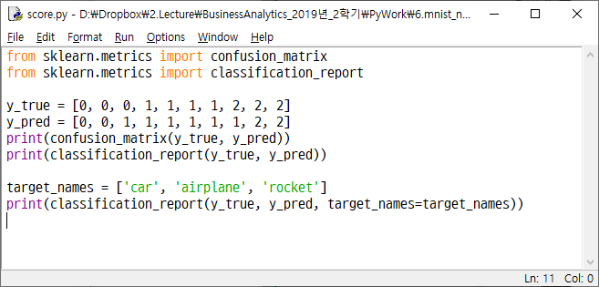

Slide 3
Confusion matrix
Example
Actual values = [0, 0, 0, 1, 1, 1, 1, 2, 2, 2]
Predicted values = [0, 0, 1, 1, 1, 1, 1, 1, 2, 2]
Confusion matrix
frequency of actual value(row) vs predicted value(column)
Predicted Actual | 0 | 1 | 2
0
1
2

Slide 4
Confusion matrix
Example
Actual values = [0, 0, 0, 1, 1, 1, 1, 2, 2, 2]
Predicted values = [0, 0, 1, 1, 1, 1, 1, 1, 2, 2]
Confusion matrix
frequency of actual value(row) vs predicted value(column)
Predicted Actual | 0 | 1 | 2
0 | 2 | 1 | 0
1 | 0 | 4 | 0
2 | 0 | 1 | 2

Slide 5




The Shepherd and the wolf
What are the type of errors that villagers made?

Slide 6
TP, TN, FP, FN
Target is labeled as True and False
If multiple classes, one of the values is considered to be true
Confusion matrix
Consider TP, TN, FP, FN for label ‘2’
Predicted Actual | 0 (False) | 1 (False) | 2 (True)
0 (False) | 2 | 1 | 0
1 (False) | 0 | 4 | 0
2 (True) | 0 | 1 | 2

Slide 7
TP (True Positive)
Number of times that model predicts TRUE when actual value is TRUE
In the following confusion matrix, TP for label ‘2’ = 2
Predicted Actual | 0 (False) | 1 (False) | 2 (True)
0 (False) | 2 | 1 | 0
1 (False) | 0 | 4 | 0
2 (True) | 0 | 1 | 2

Slide 8
TN (True Negative)
Number of times that model predicts FALSE when actual value is FALSE
In the following confusion matrix, TN for label ‘2’ = 7
Predicted Actual | 0 (False) | 1 (False) | 2 (True)
0 (False) | 2 | 1 | 0
1 (False) | 0 | 4 | 0
2 (True) | 0 | 1 | 2

Slide 9
FP (False Positive)
Number of times that model predicts True when actual value is False
In the following confusion matrix, FP for label ‘2’ = 0
Predicted Actual | 0 (False) | 1 (False) | 2 (True)
0 (False) | 2 | 1 | 0
1 (False) | 0 | 4 | 0
2 (True) | 0 | 1 | 2

Slide 10
FN (False Negative)
Number of times that model predicts False when actual value is True
In the following confusion matrix, FN for label ‘2’ = 1
Predicted Actual | 0 (False) | 1 (False) | 2 (True)
0 (False) | 2 | 1 | 0
1 (False) | 0 | 4 | 0
2 (True) | 0 | 1 | 2

Slide 11
Practice
Specify TP, TN, FP, FN for label ‘0’
Predicted Actual | 0 | 1 | 2
0 | 2 | 1 | 0
1 | 0 | 4 | 0
2 | 0 | 1 | 2

Slide 12
Accuracy
How accurate your judgement is
Accuracy = (TP + TN) / (TP+TN+FP+FN) = (2+4+2) / 10 = 0.8
Predicted Actual | 0 | 1 | 2
0 | 2 | 1 | 0
1 | 0 | 4 | 0
2 | 0 | 1 | 2

Slide 13
Problem of accuracy
There are 10 aliens and 990 humans
Model seldom predicts alien
Accuracy = (1+990) / 1000 = 0.991
Predicted Actual | Alien | Human
Alien | 1 | 9
Human | 0 | 990

Slide 14
Precision
How truly positive, when you say positive
Precision of label ‘1’ prediction = TP / (TP + FP) = 4 / (1+4+1) = 0.6667
Predicted Actual | 0 | 1 | 2
0 | 2 | 1 | 0
1 | 0 | 4 | 0
2 | 0 | 1 | 2

Slide 15
Recall
How much you say positive, among all true
Recall of label ‘0’ prediction = TP / (TP + FN) = 2 / (2+1+0) = 0.6667
Predicted Actual | 0 | 1 | 2
0 | 2 | 1 | 0
1 | 0 | 4 | 0
2 | 0 | 1 | 2

Slide 16
Precision vs. Recall
There are 10 alien and 990 humans
Model A : seldom predicts alien
Accuracy = (TP+TN) / (TP+TN+FP+FN) = (1+990) / 1000 = 99.1%
Precision = TP / (TP + FP) = 1 / (1 + 0) = 100%
Recall = TP / (TP + FN) = 1 / (1 + 9) = 10%
Model B : often predicts alien, sometimes wrong
Accuracy = (TP+TN) / (TP+TN+FP+FN) = (9+981) / 1000 = 99.0%
Precision = TP / (TP + FP) = 9 / (9 + 9) = 50%
Recall = TP / (TP + FN) = 9 / (9 + 1) = 90%
Predicted Actual | Alien | Human
Alien | 1 | 9
Human | 0 | 990
Predicted Actual | Alien | Human
Alien | 9 | 1
Human | 9 | 981

Slide 17
F1 score
When data labels’ distribution is balanced, accuracy can be good measure
But when data labels’ distribution is highly biased, accuracy measure misleads
In such case, F1 score can be useful
F1 score = harmonic mean of precision and accuracy = 2*precision*recall / (precision + recall)

Slide 18
Accuracy, Precision, Recall, F1 score
Model A : seldom predicts alien
Accuracy = (TP+TN) / (TP+TN+FP+FN) = (1+990) / 1000 = 99.1%
Precision = TP / (TP + FP) = 1 / (1 + 0) = 100%
Recall = TP / (TP + FN) = 1 / (1 + 9) = 10%
F1 score = 2*100%*10% / (100%+10%) = 0.182
Model B : often predicts alien, sometimes wrong
Accuracy = (TP+TN) / (TP+TN+FP+FN) = (9+981) / 1000 = 99.0%
Precision = TP / (TP + FP) = 9 / (9 + 9) = 50%
Recall = TP / (TP + FN) = 9 / (9 + 1) = 90%
F1 score = 2*50%*90% / (50%+90%) = 0.643
Predicted Actual | Alien | Human
Alien | 1 | 9
Human | 0 | 990
Predicted Actual | Alien | Human
Alien | 9 | 1
Human | 9 | 981

Slide 20
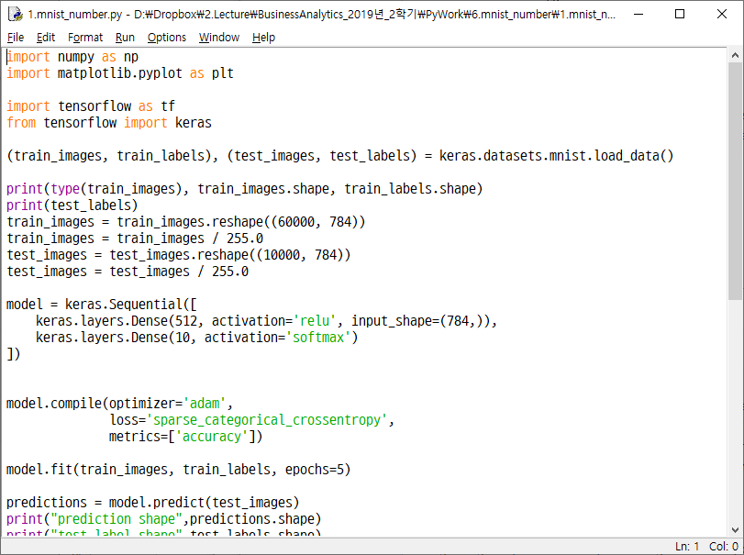

Slide 21
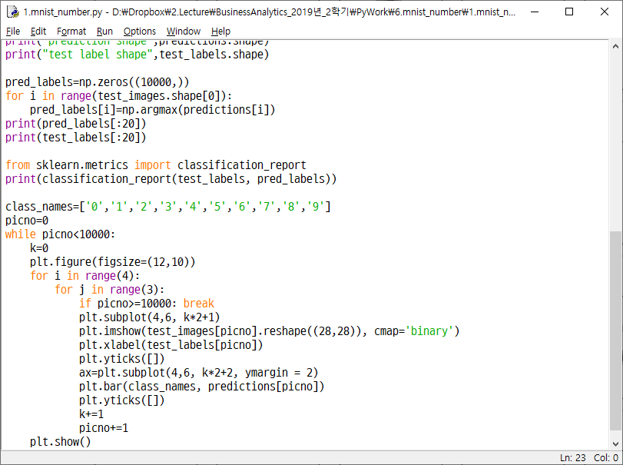

Slide 22
